Slide 1
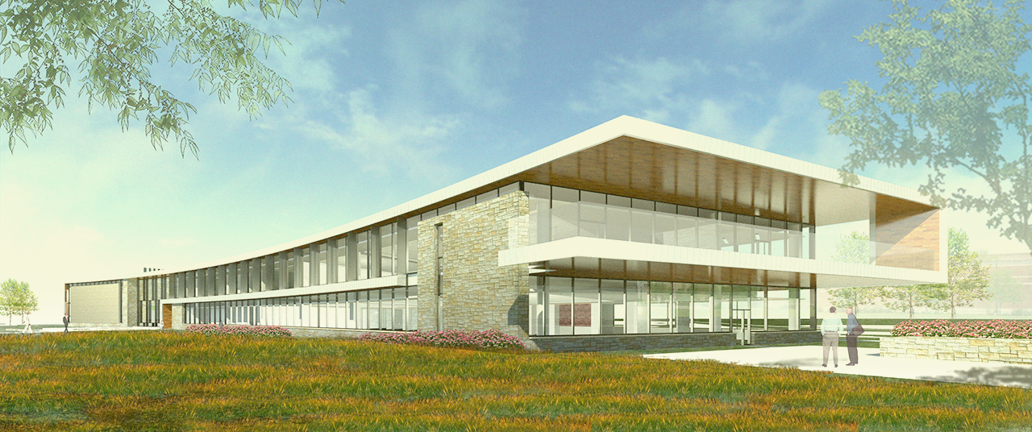
Frederick College of Cardiology
Arlington Heights, IL
Schematic Design Presentation
by Rob Currie

Slide 2
- Education Facility
- Auditorium
- Office Space

Slide 3
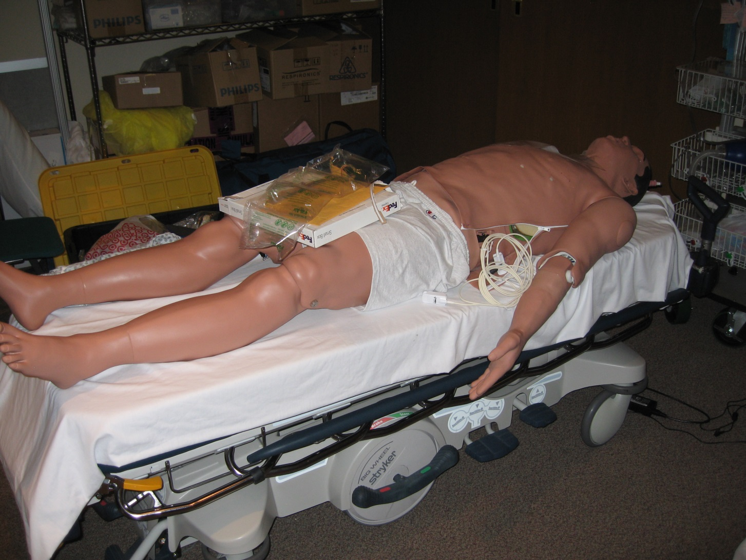
The Manikin

Slide 4
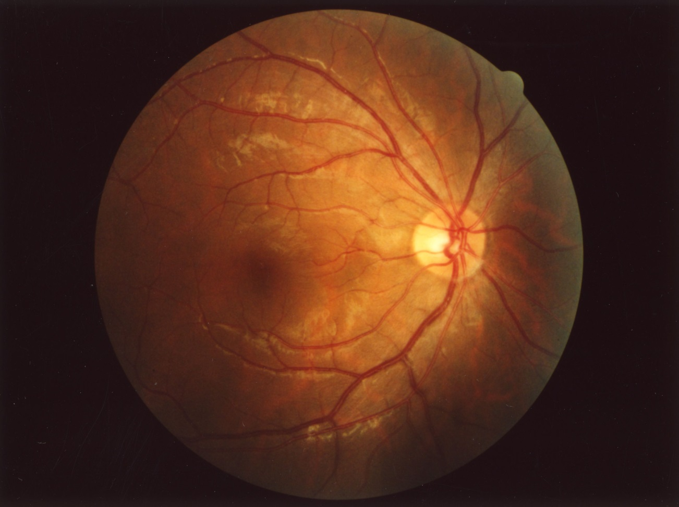

Slide 5
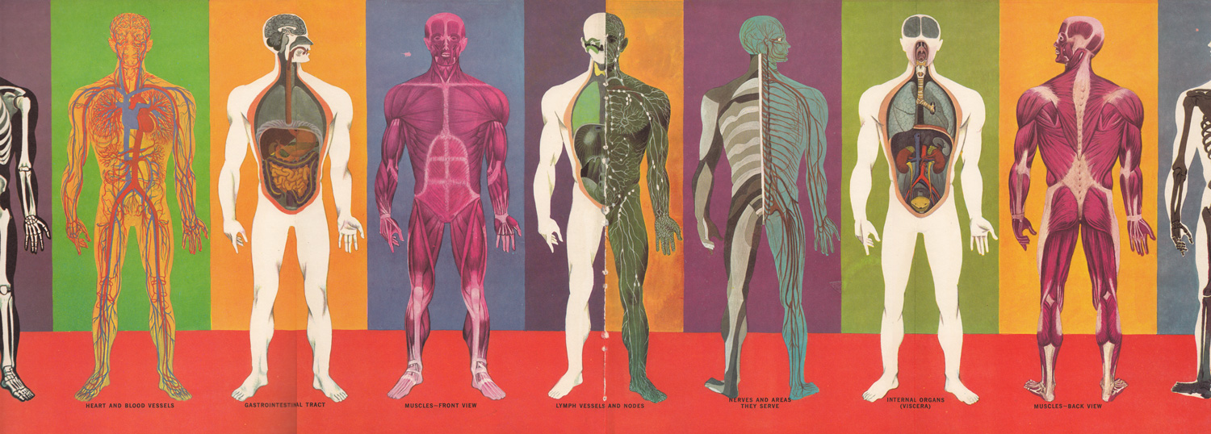

Slide 6
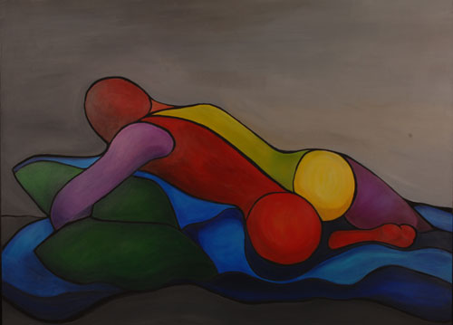

Slide 7
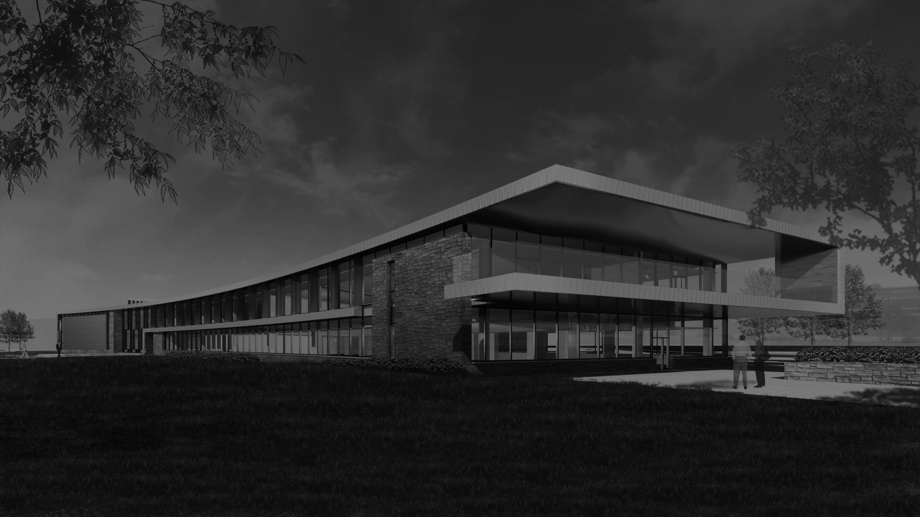
Exterior/Facade> Schematic Design

Slide 8
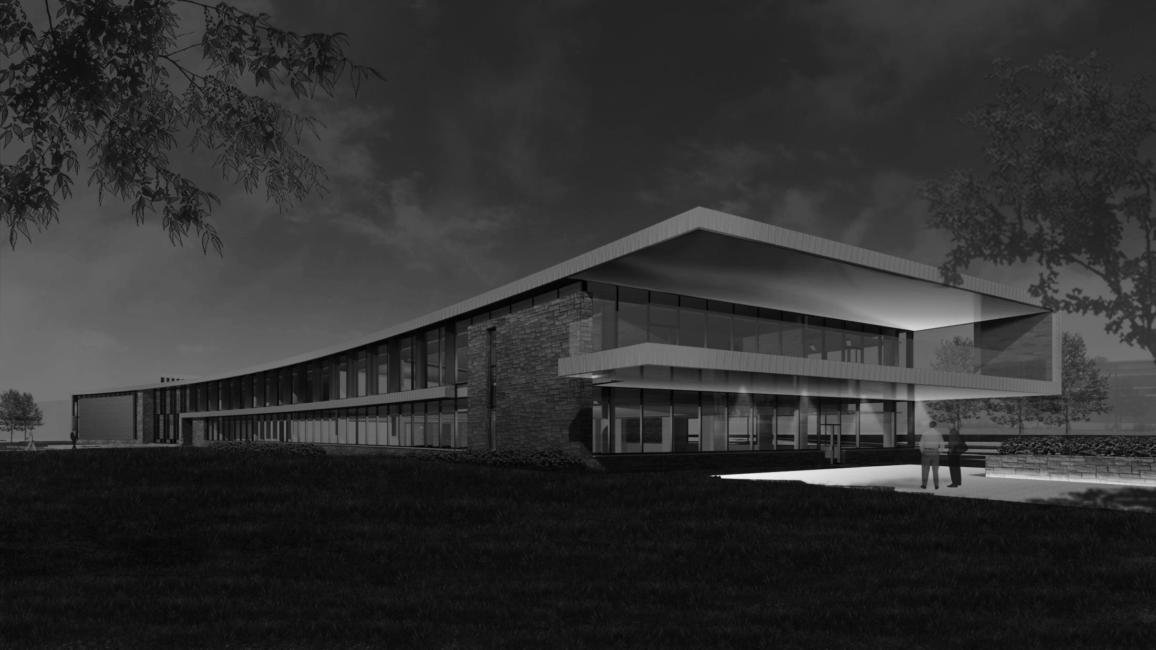
Exterior/Facade> Schematic Design

Slide 9
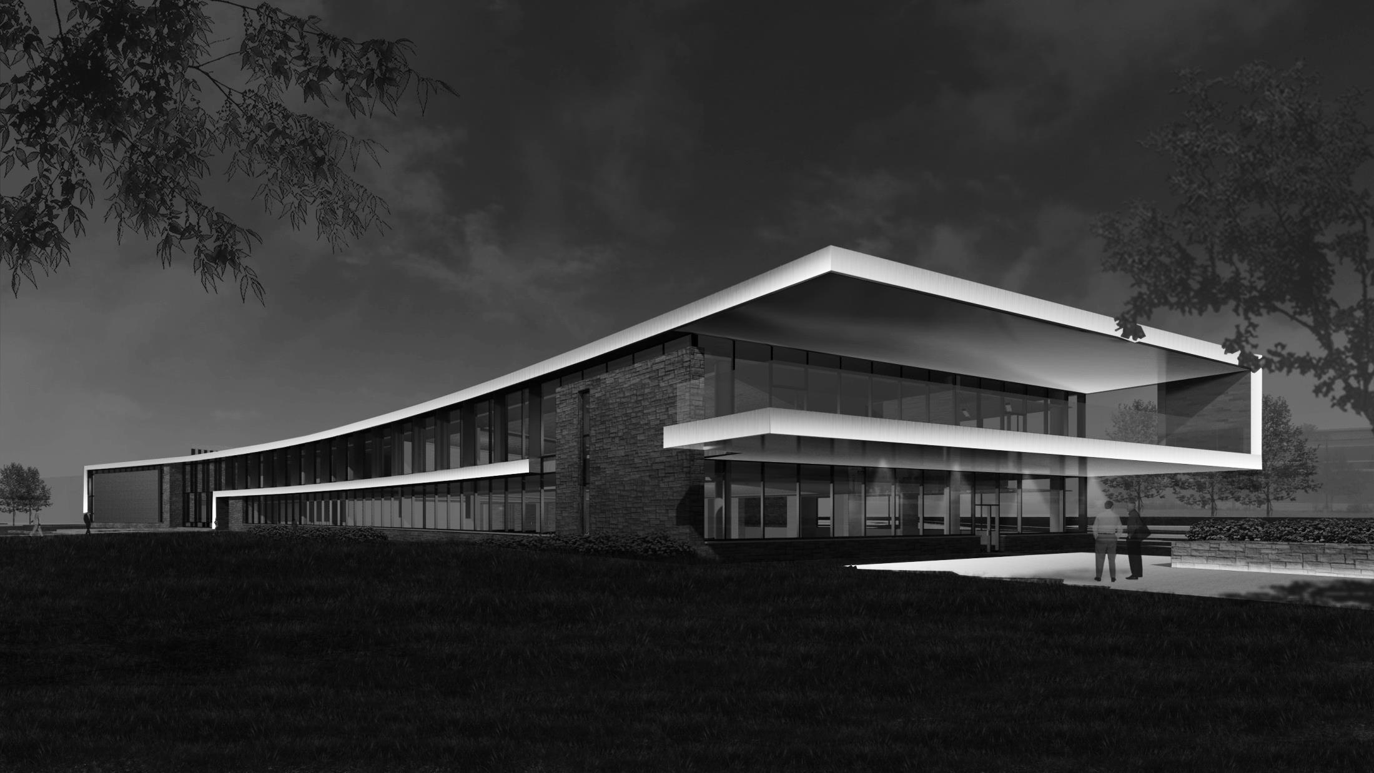
Exterior/Facade> Schematic Design

Slide 10
Exterior/Facade> Schematic Design
+ Way Finding
+ Orientation
+ Reveal Architecture

Slide 11
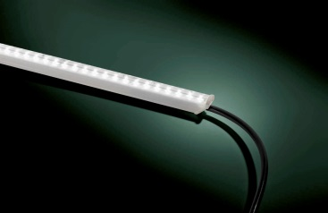
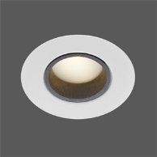
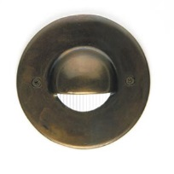
Exterior/Facade> Schematic Design
+ Way Finding
+ Orientation
+ Reveal Architectural Form

Slide 12
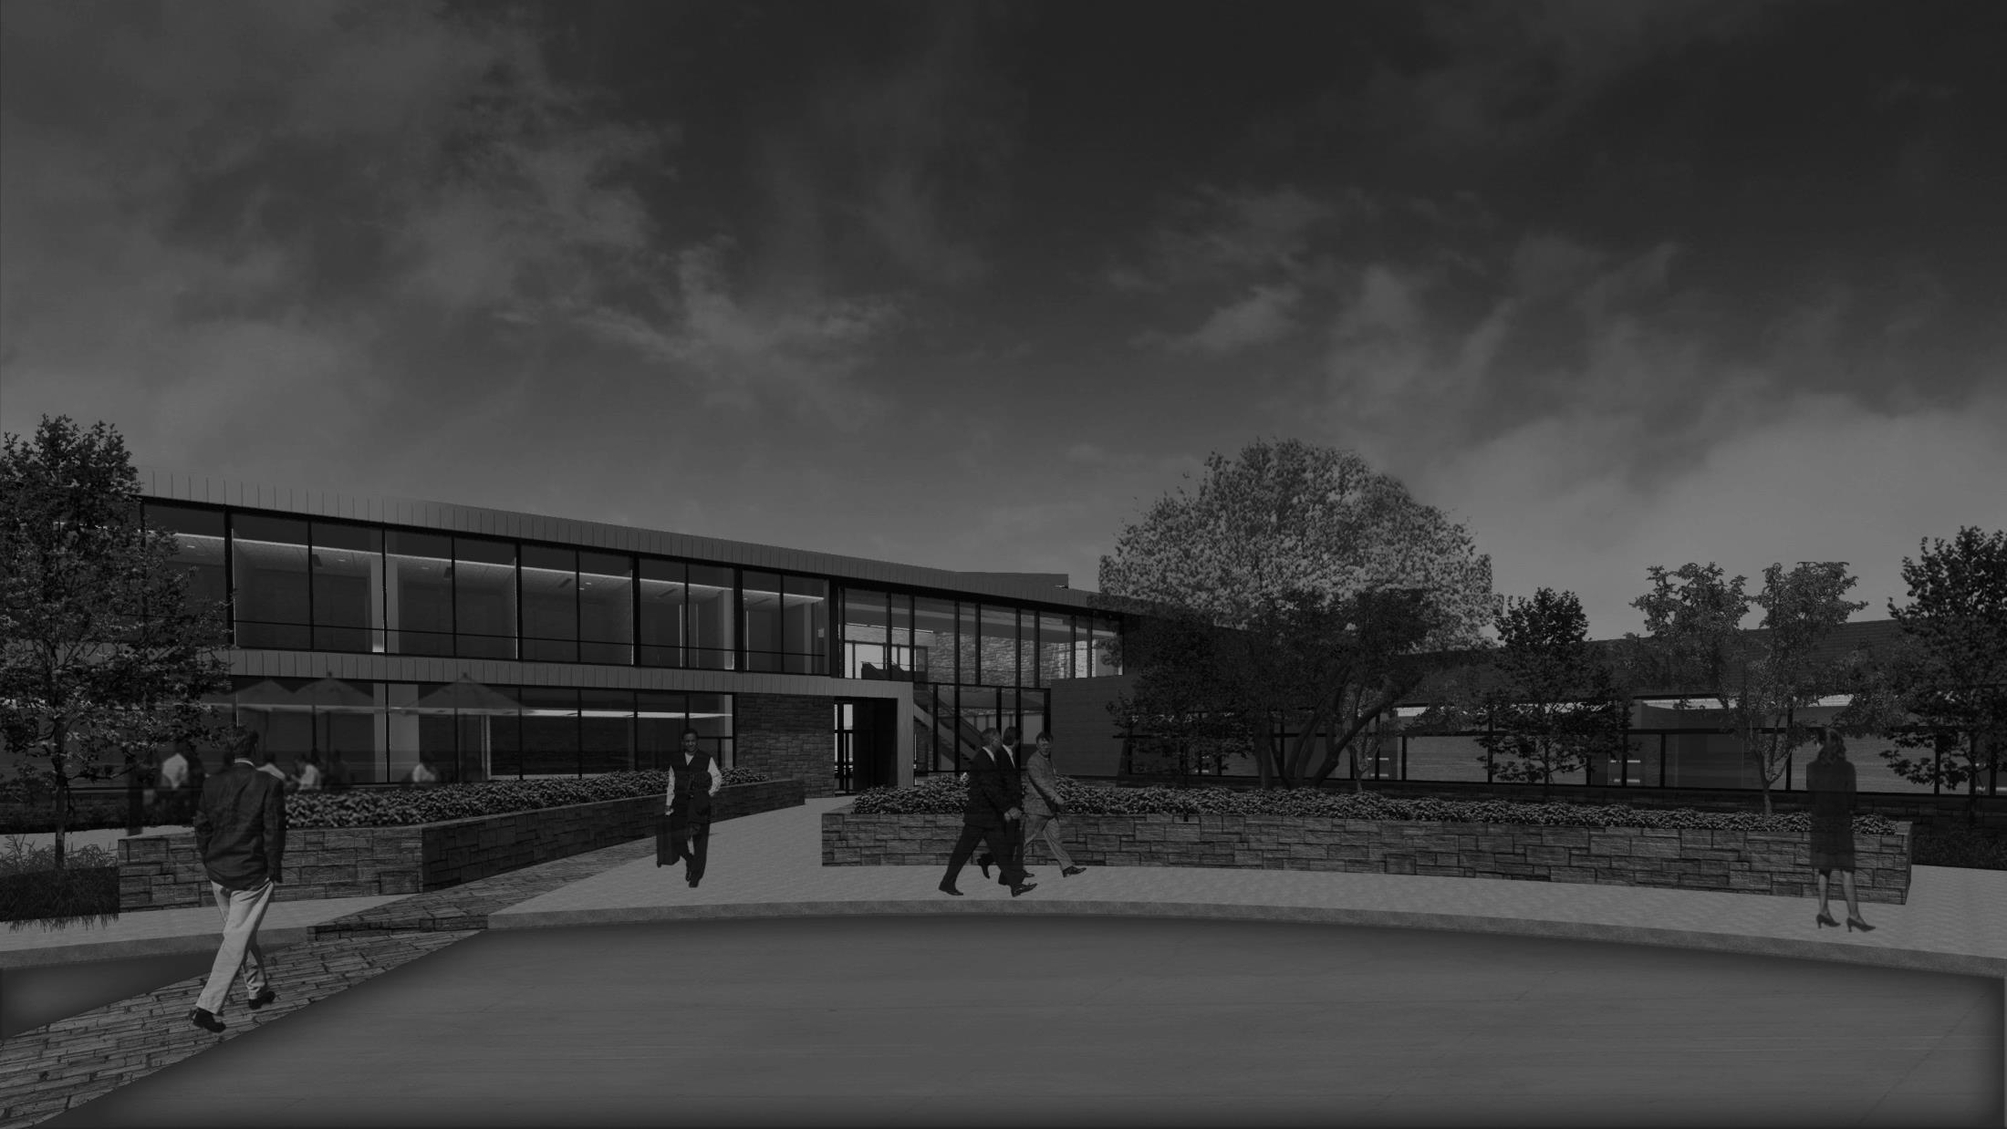
Exterior/Facade> Schematic Design

Slide 13
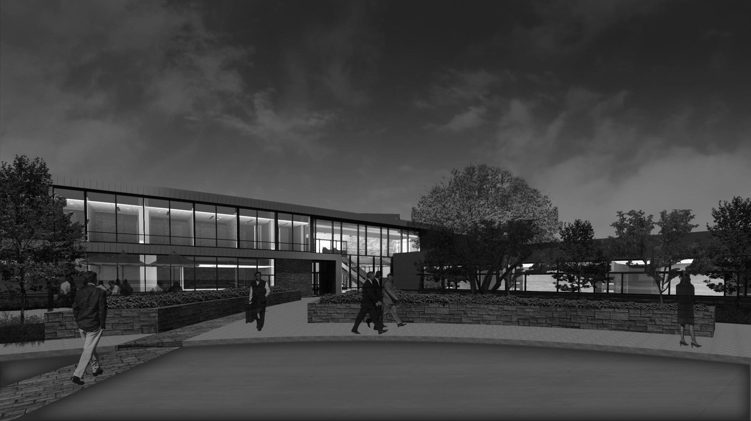
Exterior/Facade> Schematic Design

Slide 14
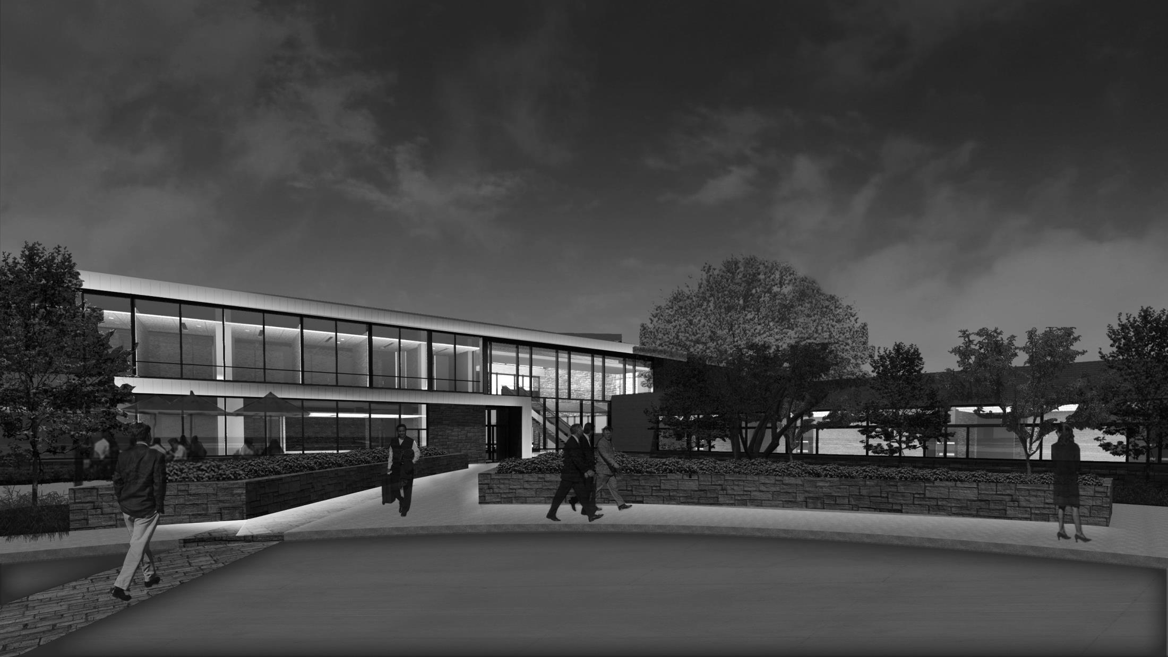
Exterior/Facade> Schematic Design
+ Light Trespass (LZ2)
+ Sky Glow
+ Timed Controls

Slide 15
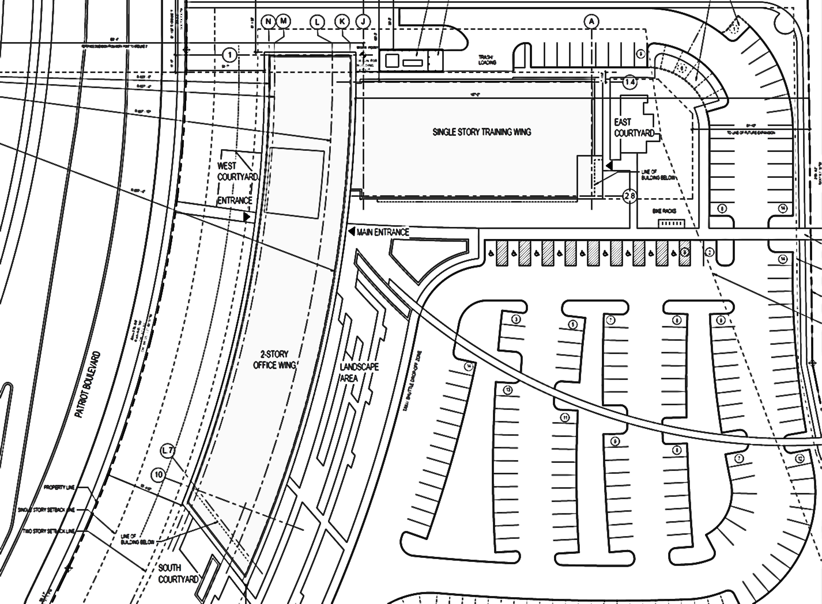
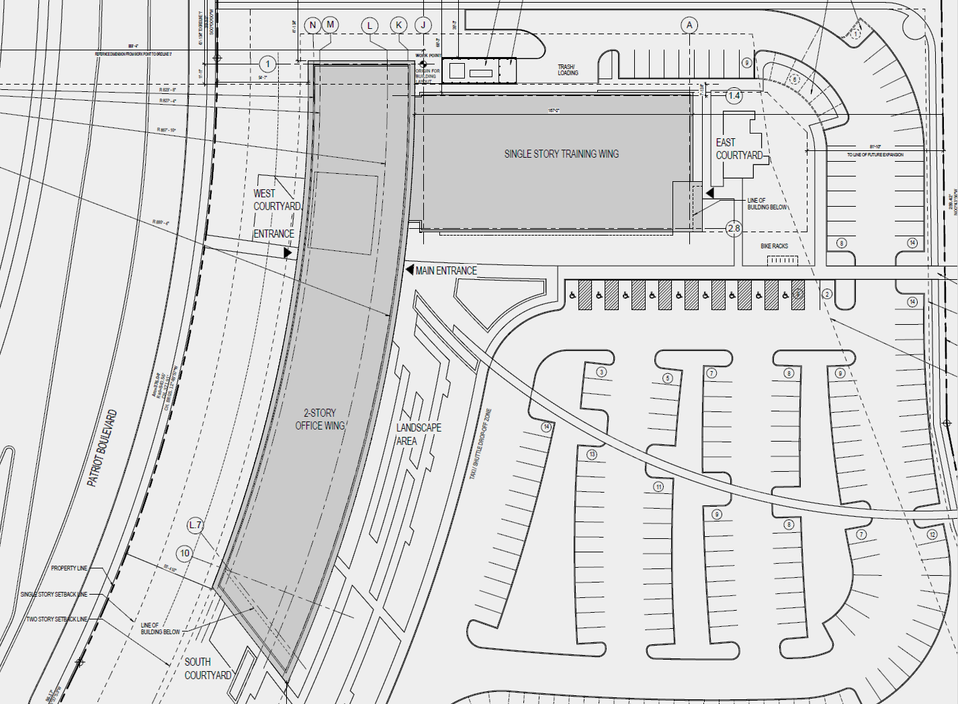

LOBBY
Main Entrance
48,000 sq. ft.

Slide 16
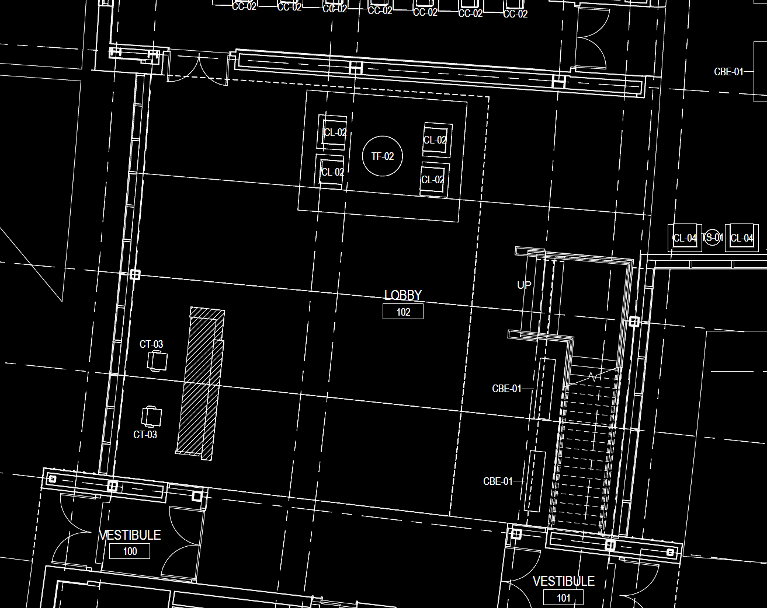
Main Lobby > Floor Plan

Slide 17
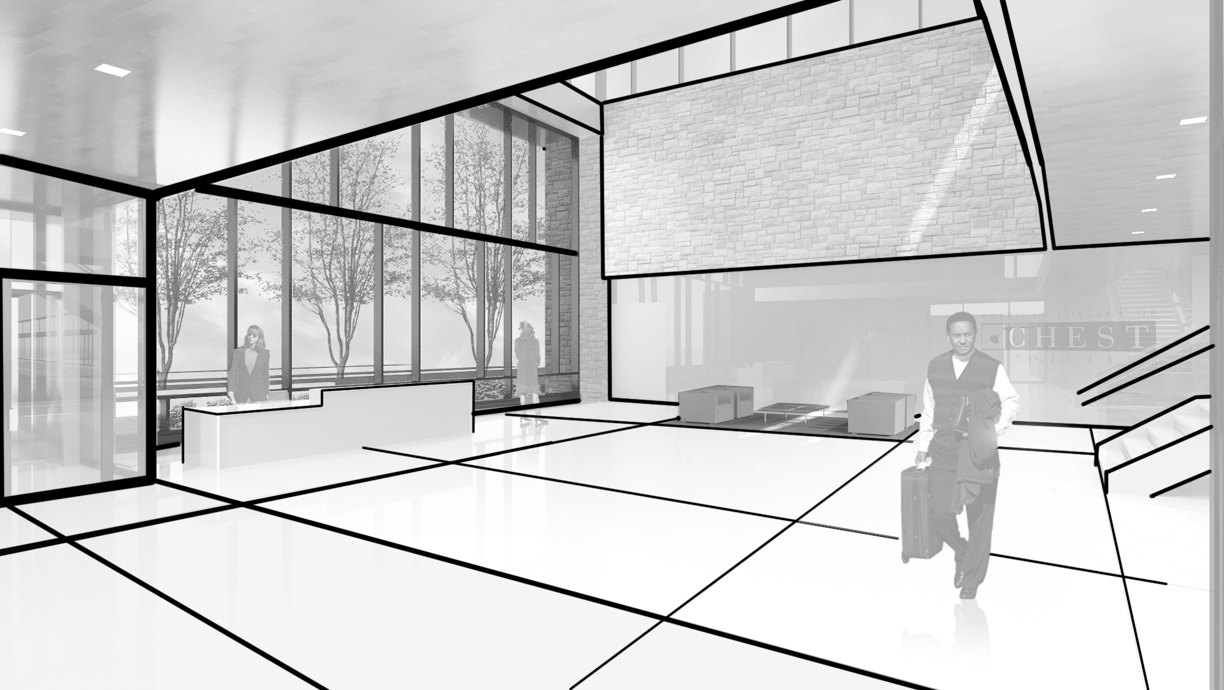
Main Lobby > Schematic Design 1

Slide 18
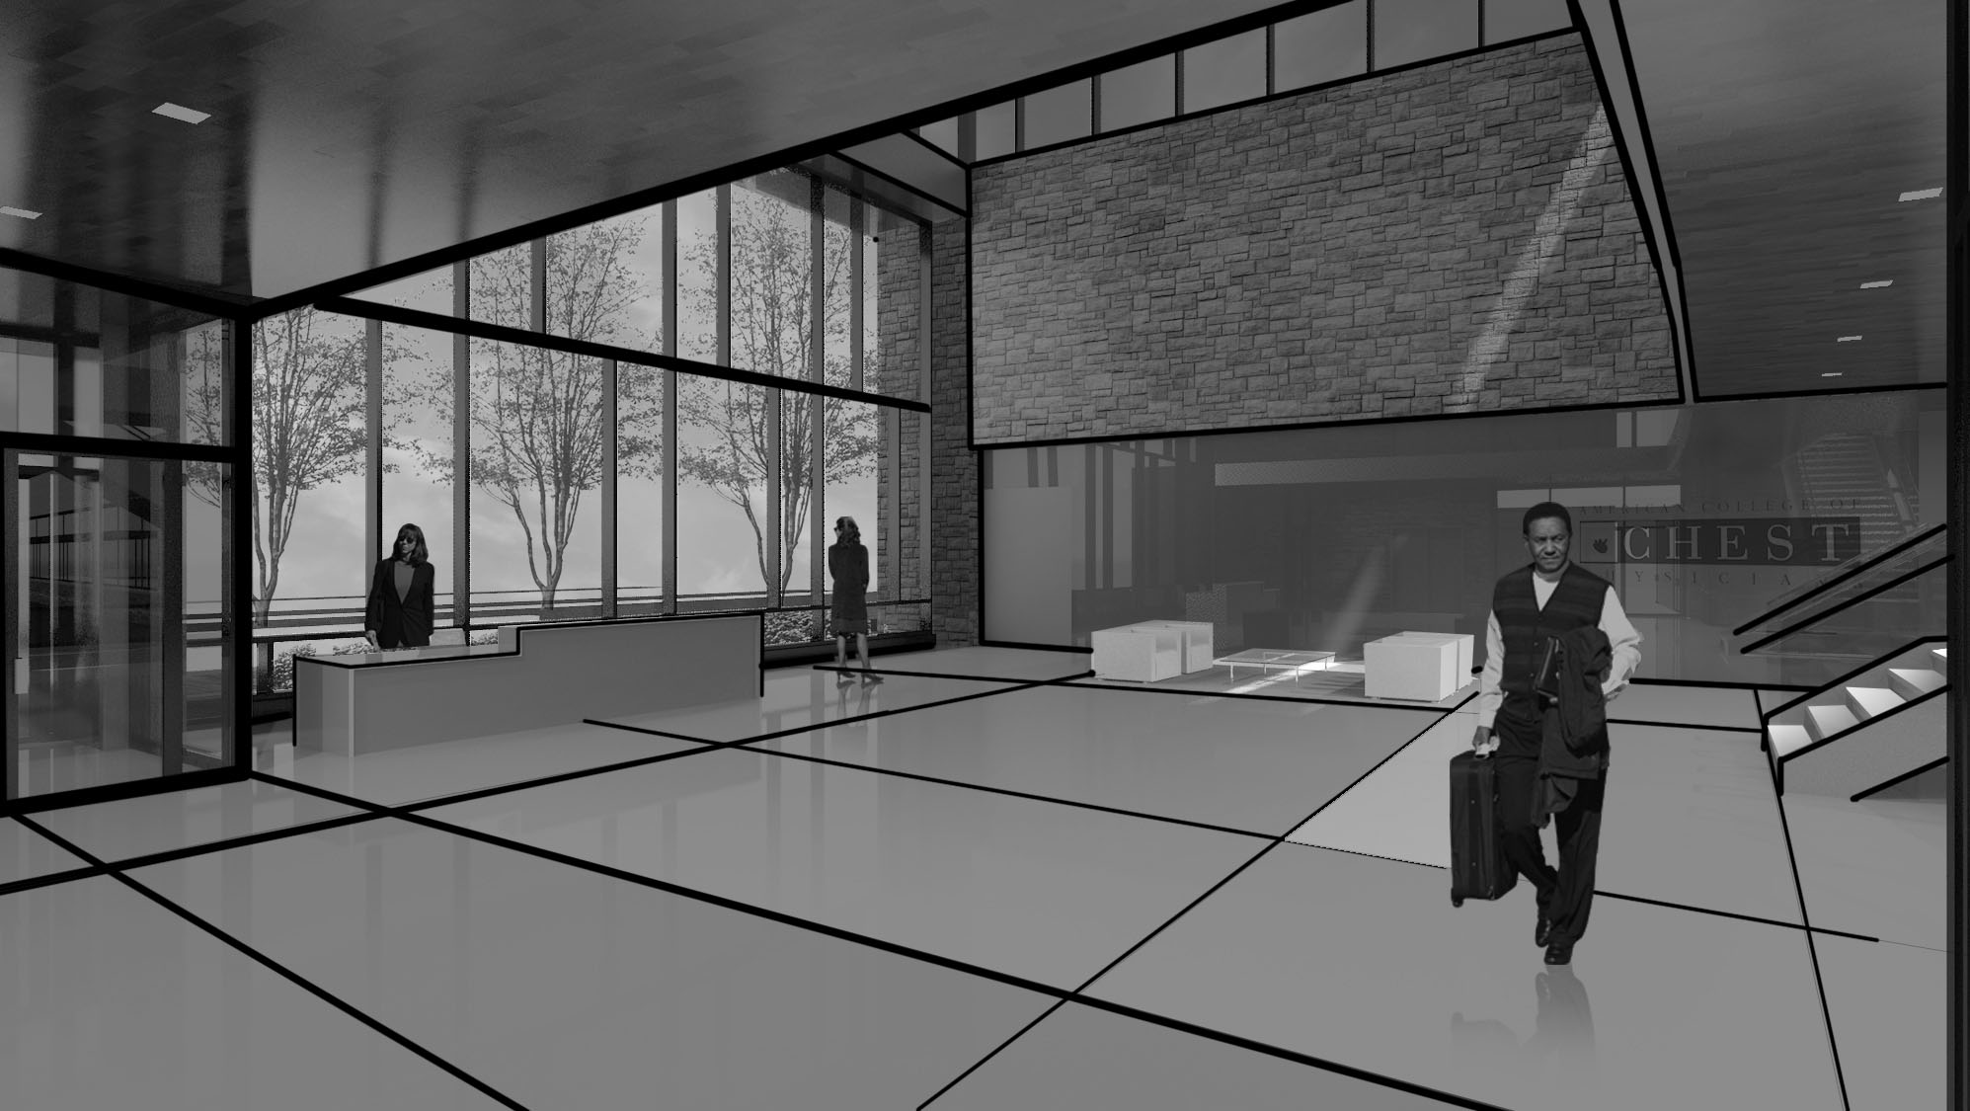
Main Lobby > Schematic Design 1

Slide 19
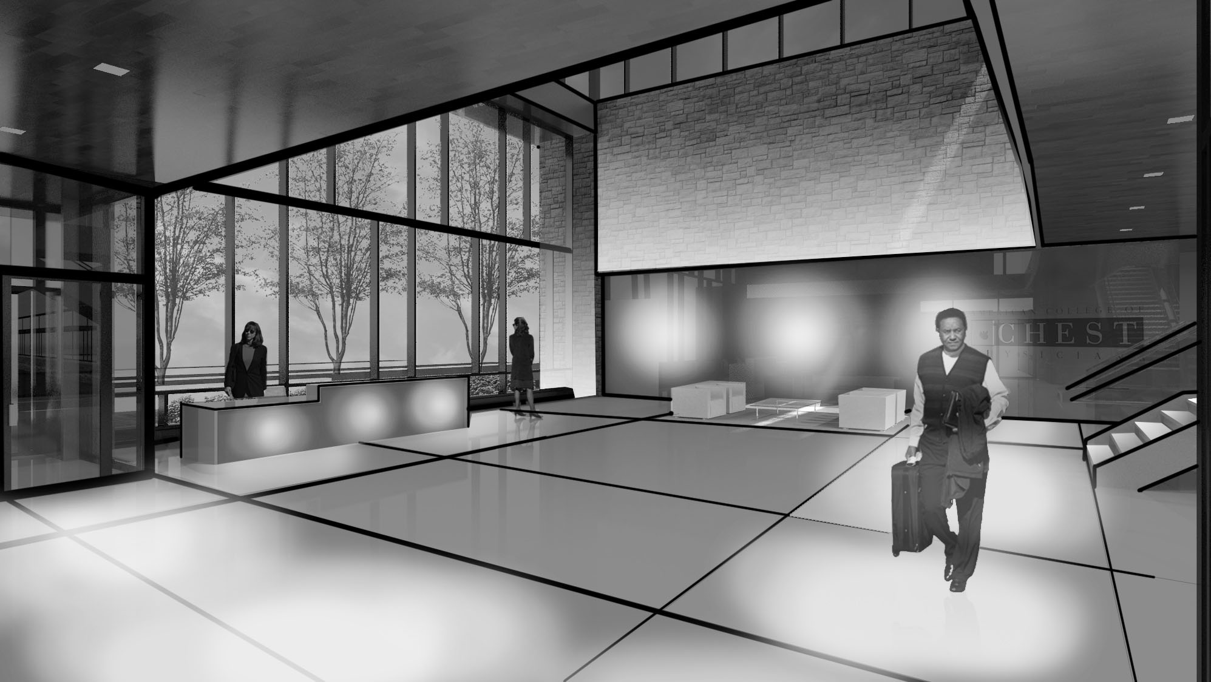
Main Lobby > Schematic Design 1
+ Way Finding
+ Transitional Brightness
+ Focus Points of Interest

Slide 20
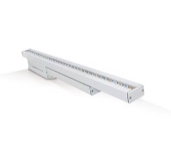
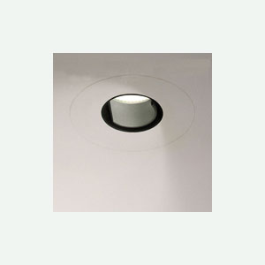
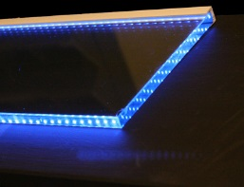
Main Lobby > Schematic Design 1
+ Way Finding
+ Transitional Brightness
+ Focus Points of Interest

Slide 21
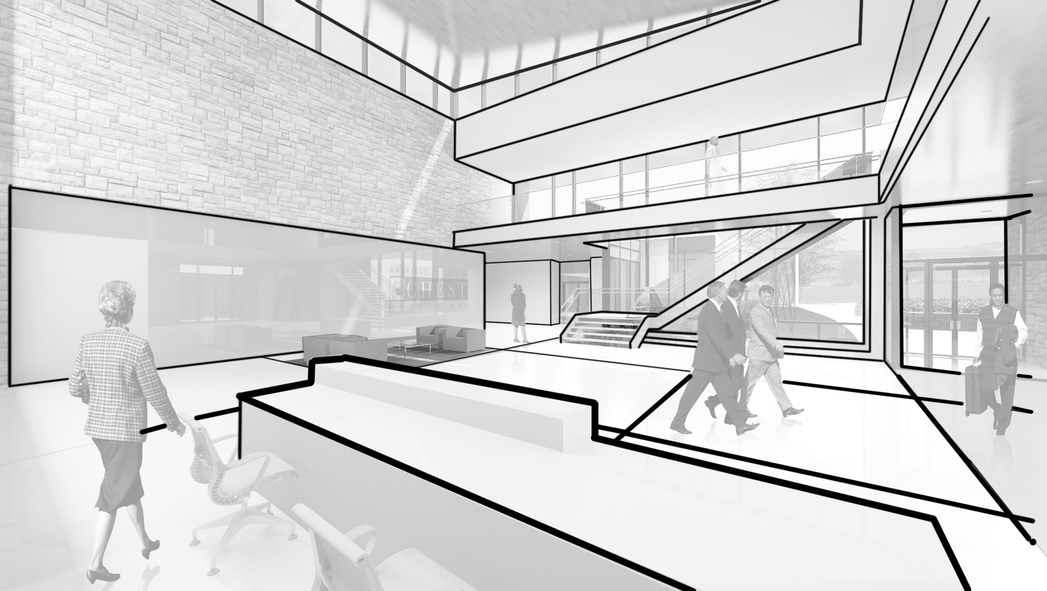
Main Lobby > Schematic Design 2

Slide 22
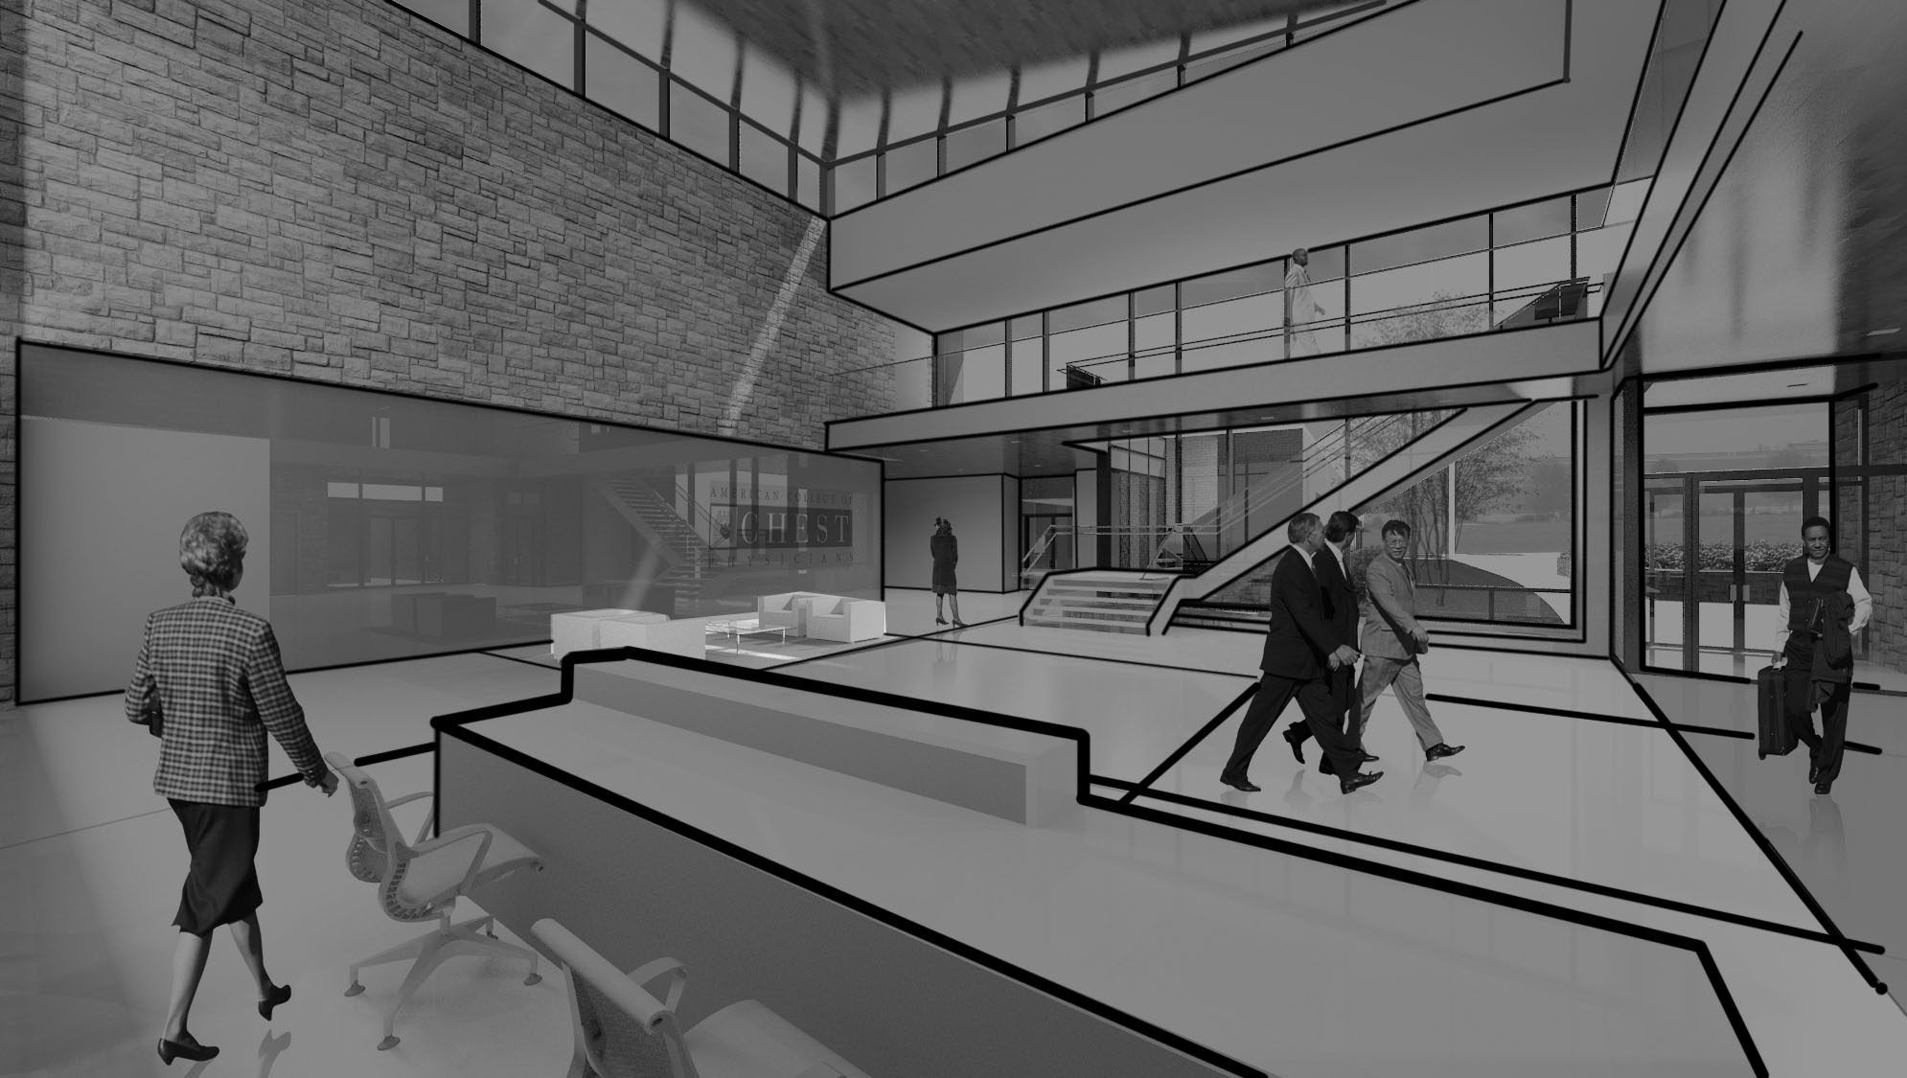
Main Lobby > Schematic Design 2

Slide 23
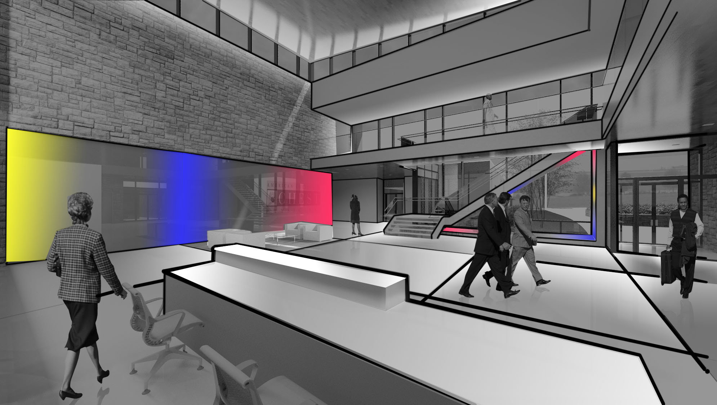
Main Lobby > Schematic Design 2

Slide 24
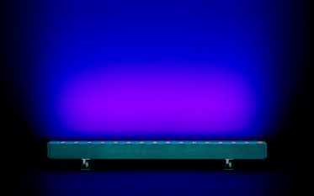
Main Lobby > Schematic Design 2
+ Way Finding
+ Transitional Brightness
+ Focus Points of Interest

Slide 25
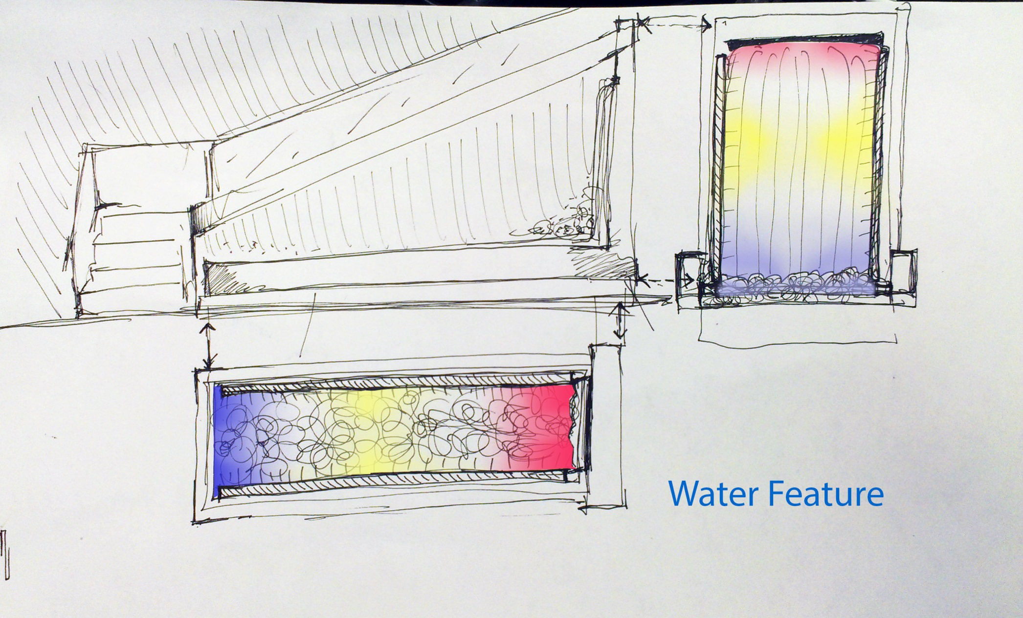
Main Lobby > Schematic Design 2
Linear LED rgb fixture

Slide 26
Main Lobby > Schematic Design 3

Slide 27
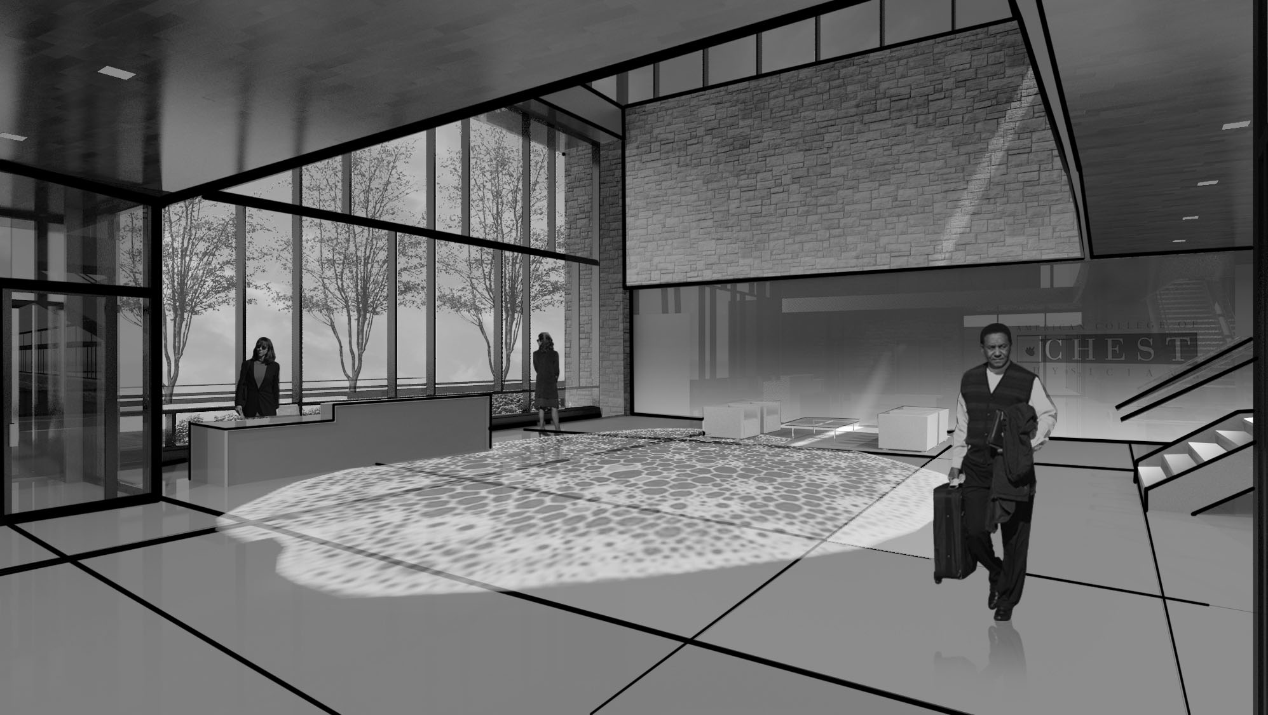
Main Lobby > Schematic Design 3
This Moves!

Slide 28
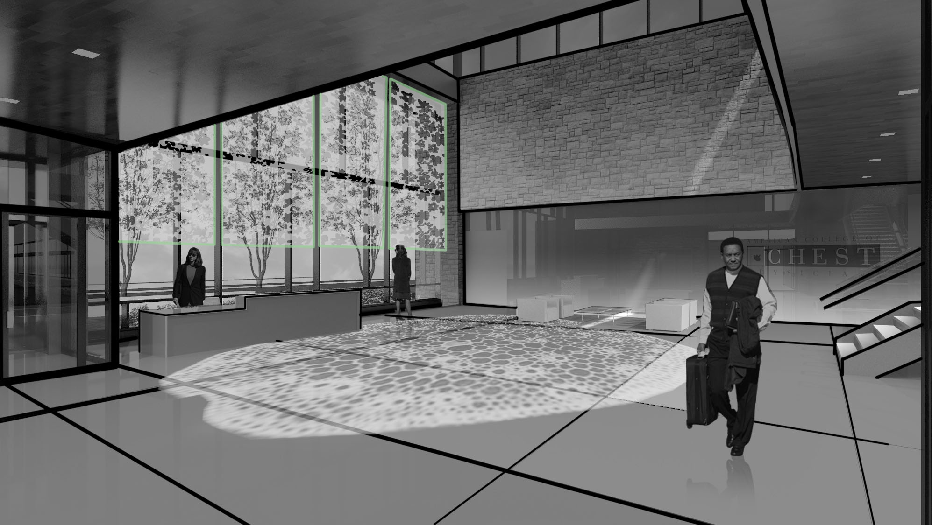
Main Lobby > Schematic Design 3

Slide 29
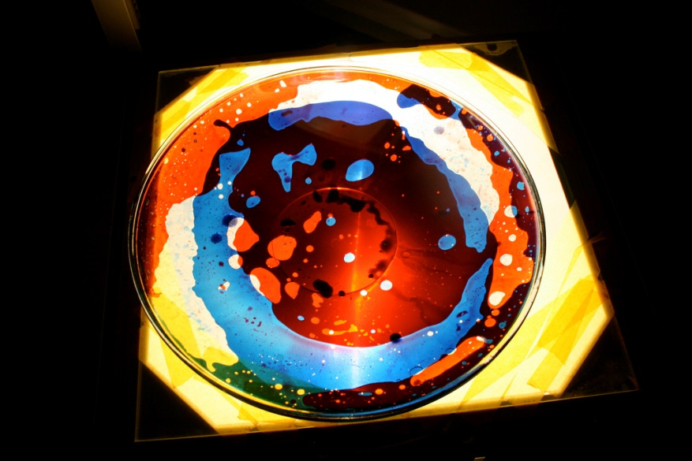
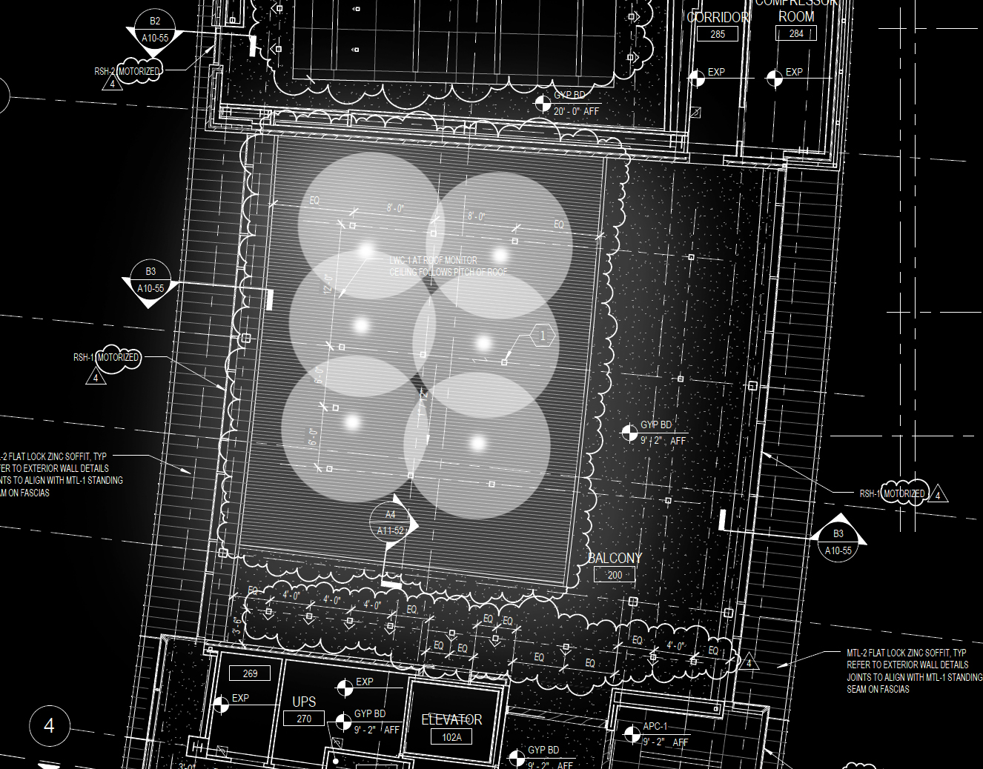
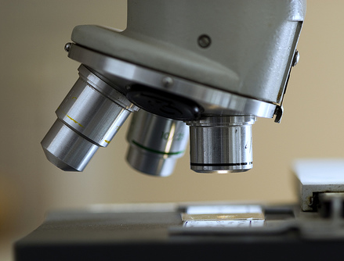
Main Lobby > Schematic Design 3

Slide 30
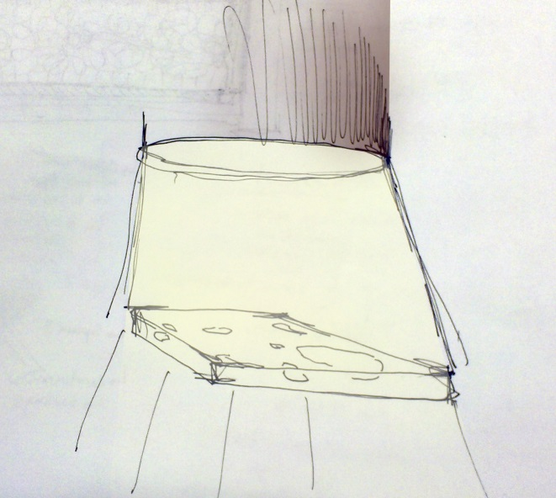
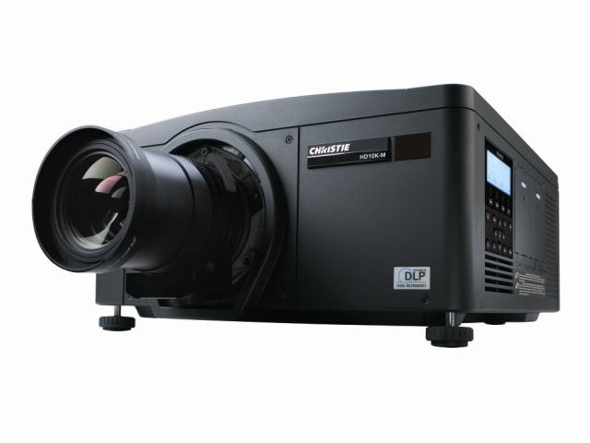
Main Lobby > Schematic Design 3

Slide 31
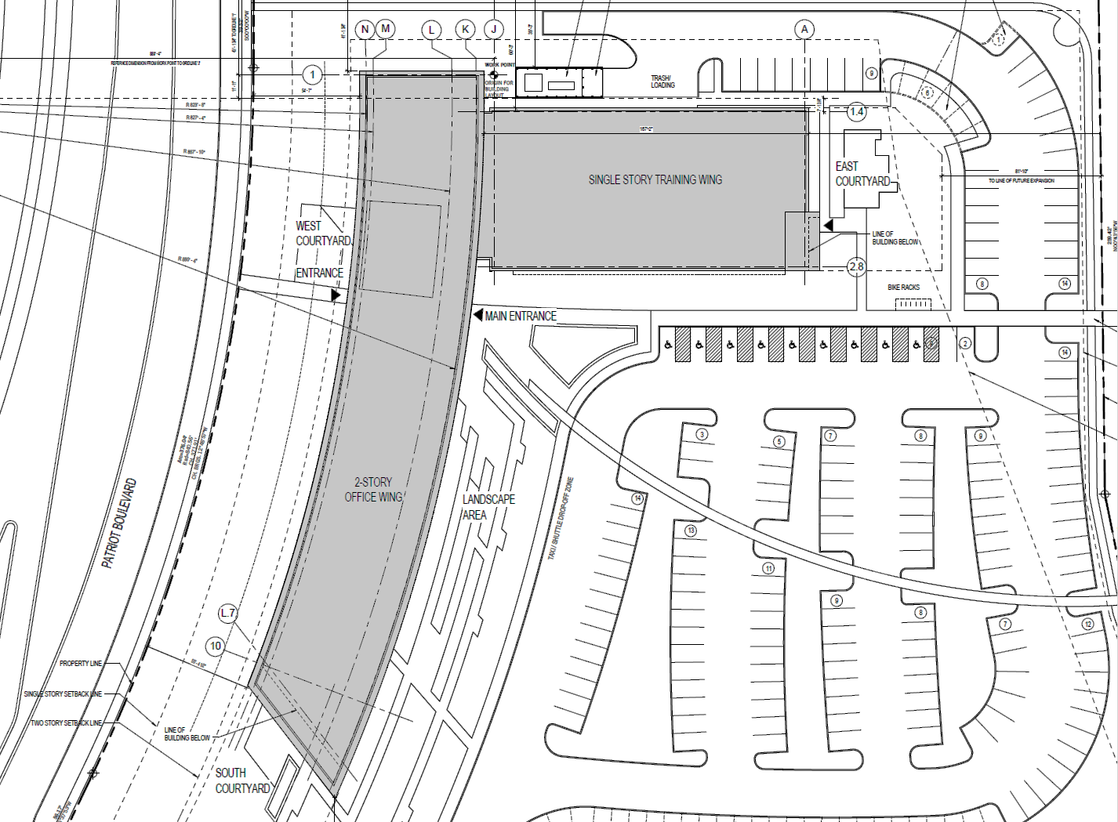
Open Office > Floor Plan
OFFICE

Slide 32
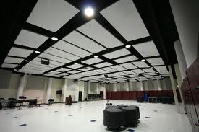
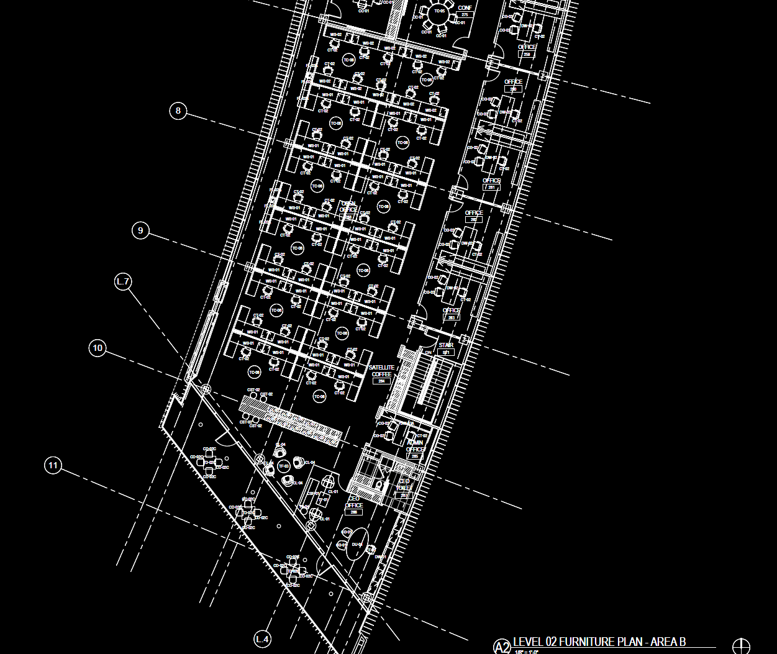
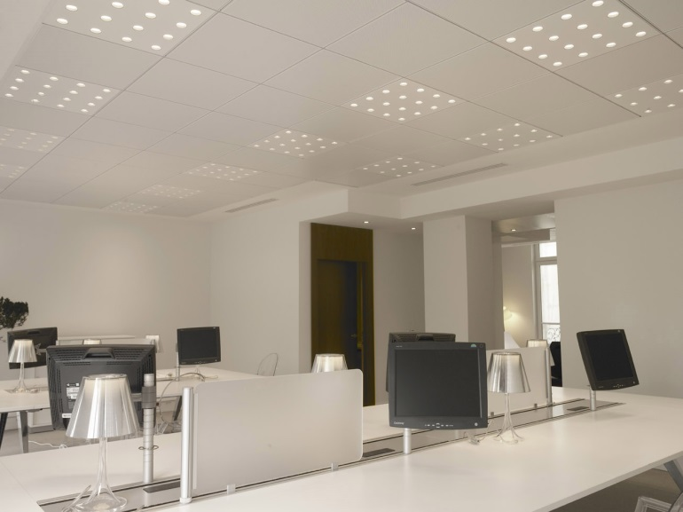
Open Office > Schematic Design
Office

Slide 33
Open Office > Schematic Design
Office

Slide 34
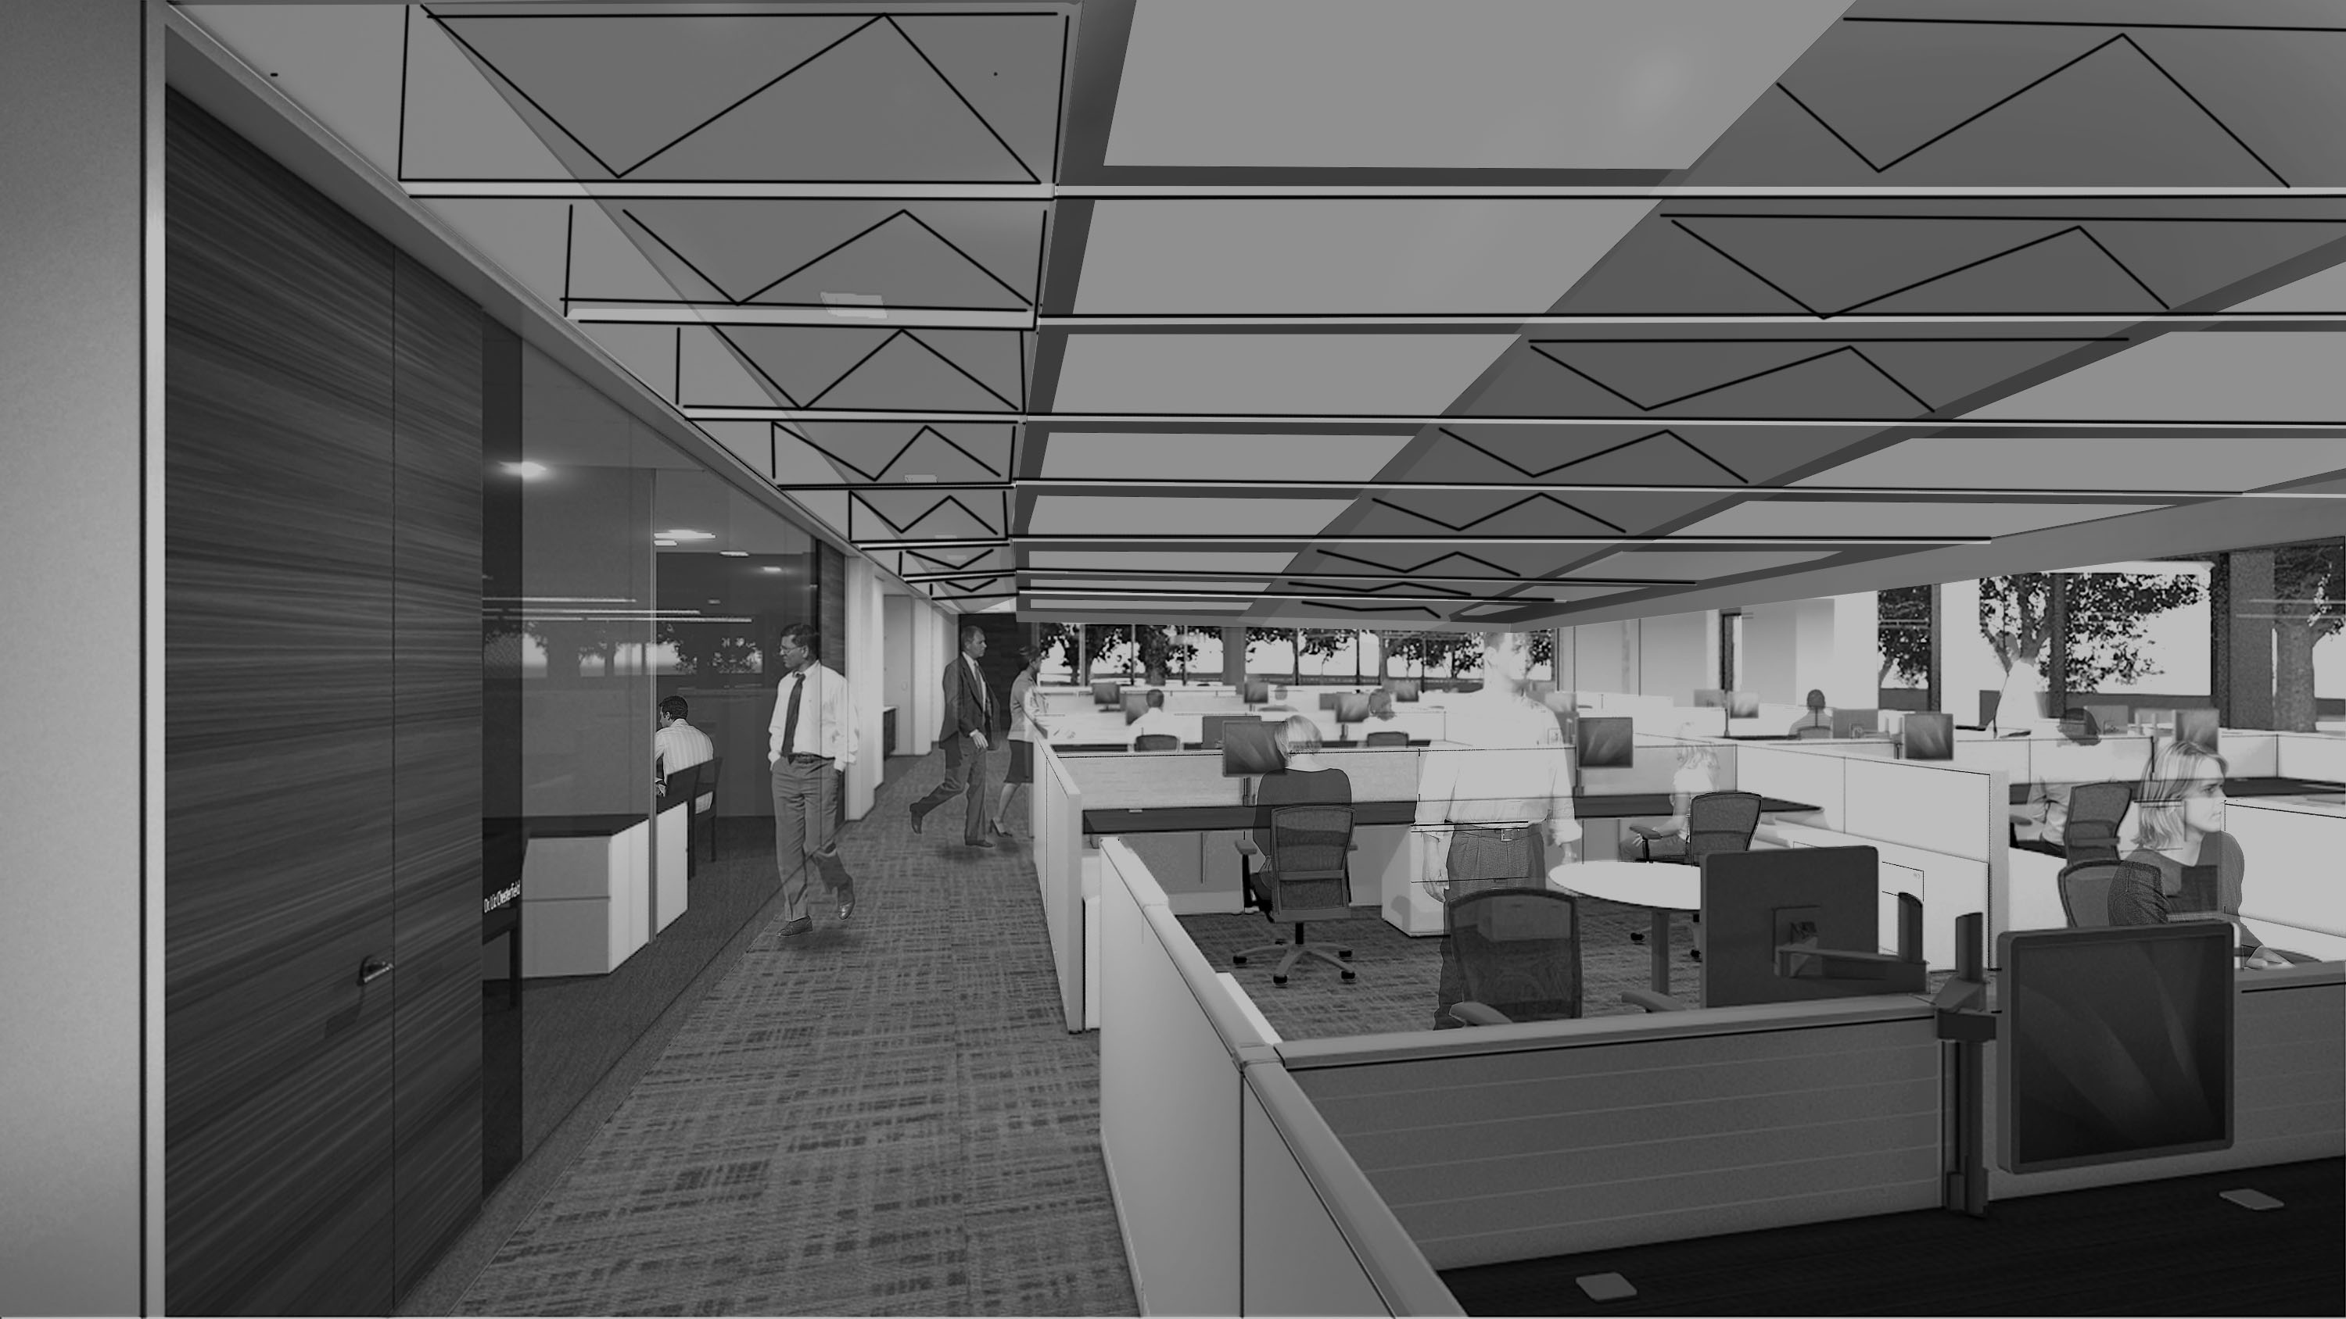
Open Office > Schematic Design
Office

Slide 35
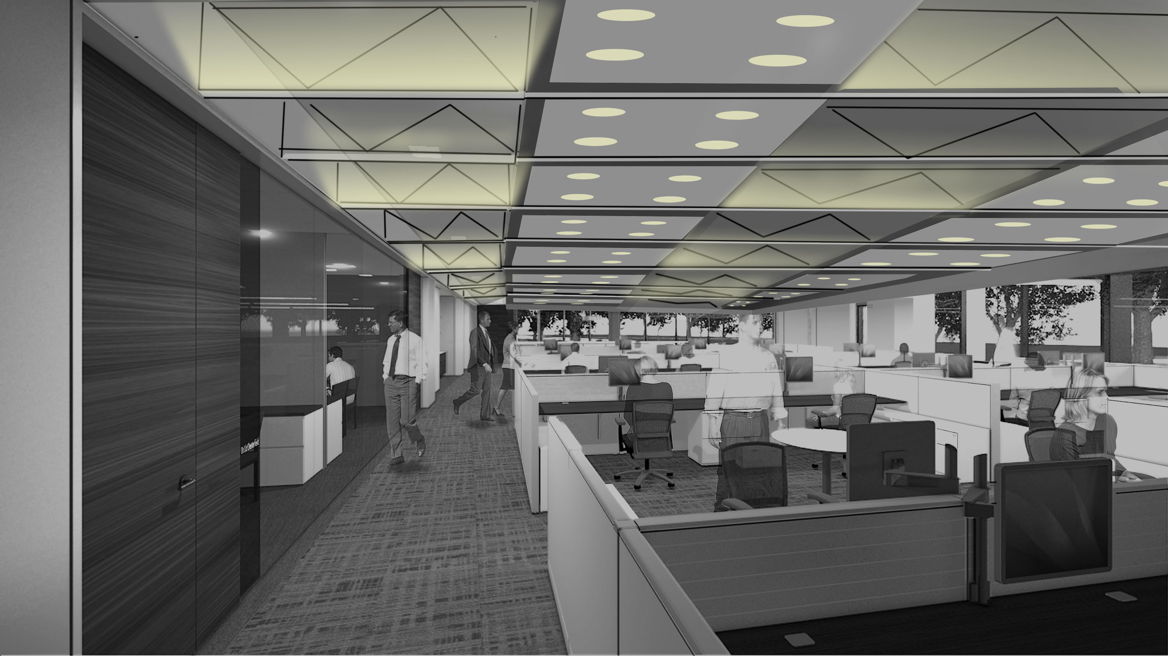
Open Office > Schematic Design
Office

Slide 36
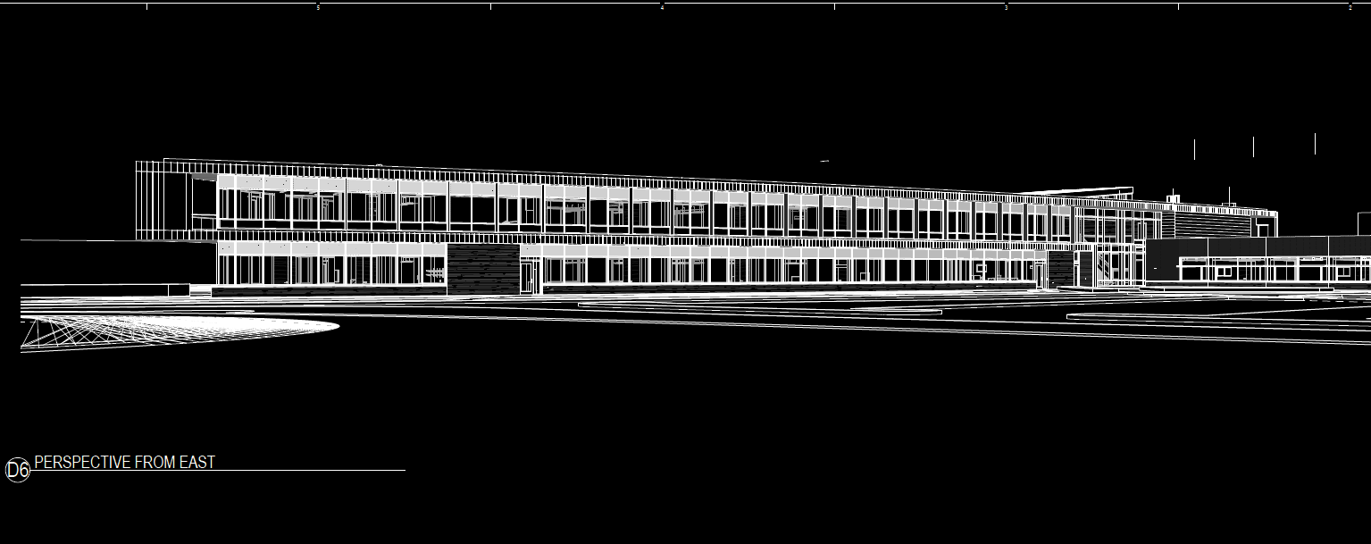
Open Office > Schematic Design
Office
+ Direct Glare Control
+ Provide Visual Rest
+ Utilize and Control Daylight

Slide 37
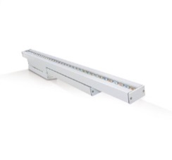
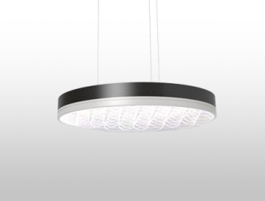
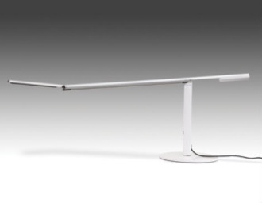
Open Office > Schematic Design
Office
+ Direct Glare Control
+ Provide Visual Rest
+ Utilize and Control Daylight

Slide 38
Auditorium> Floor Plan
AUDITORIUM

Slide 39
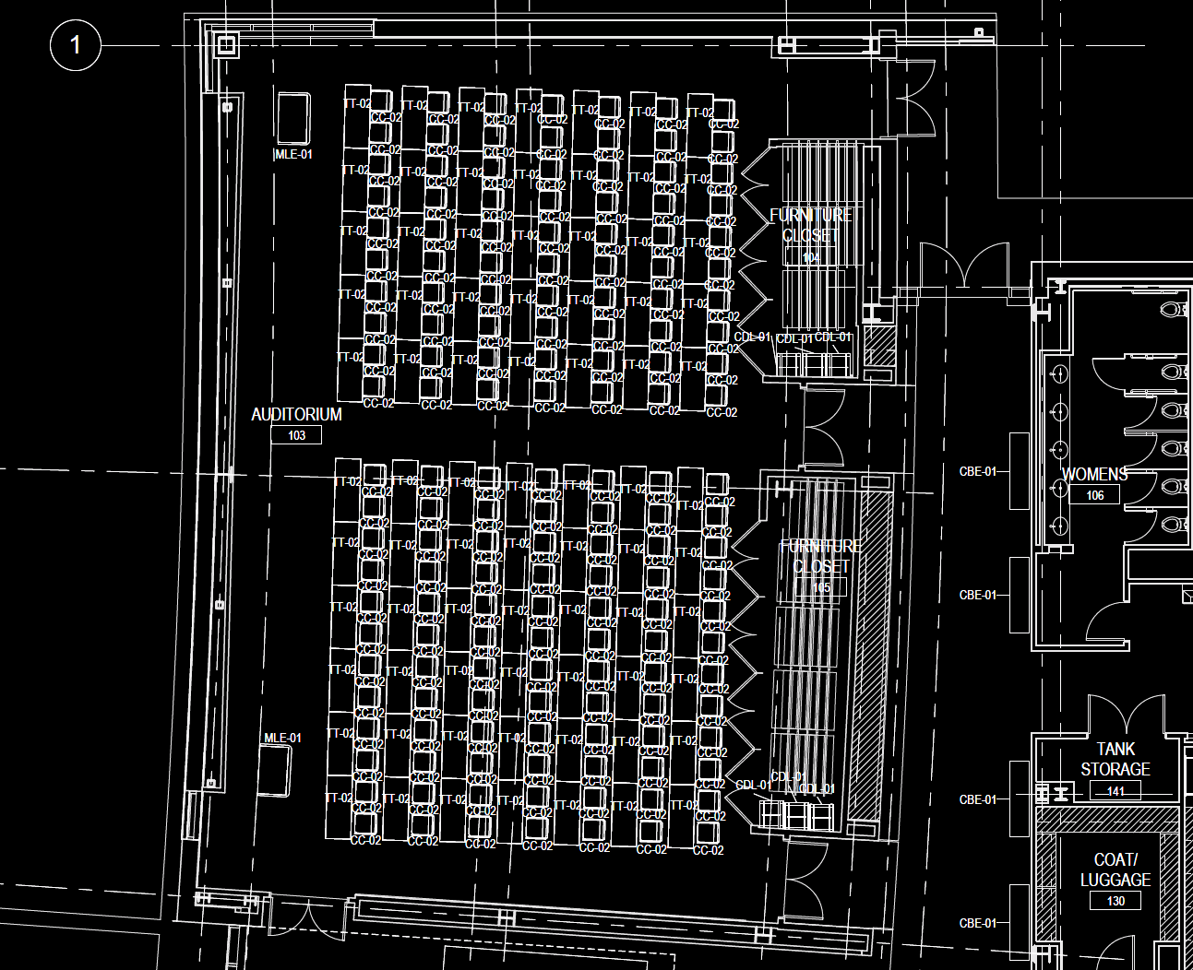
Auditorium> Floor Plan

Slide 40
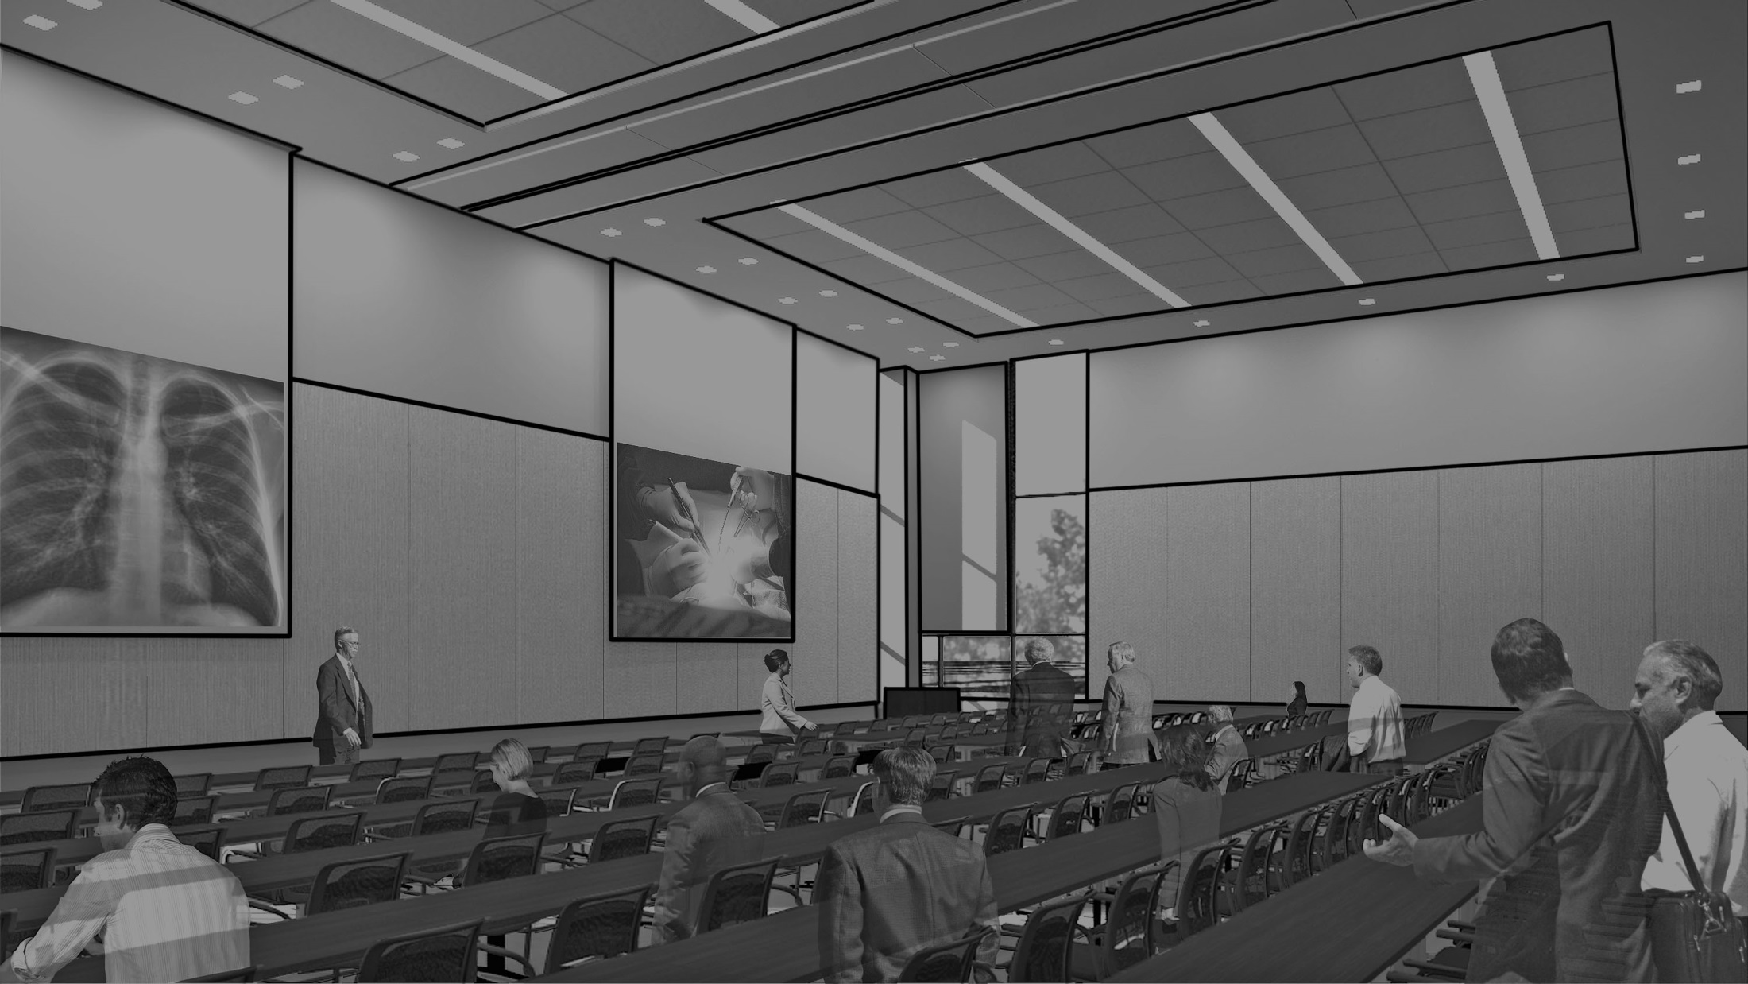
Auditorium> Schematic Design

Slide 41
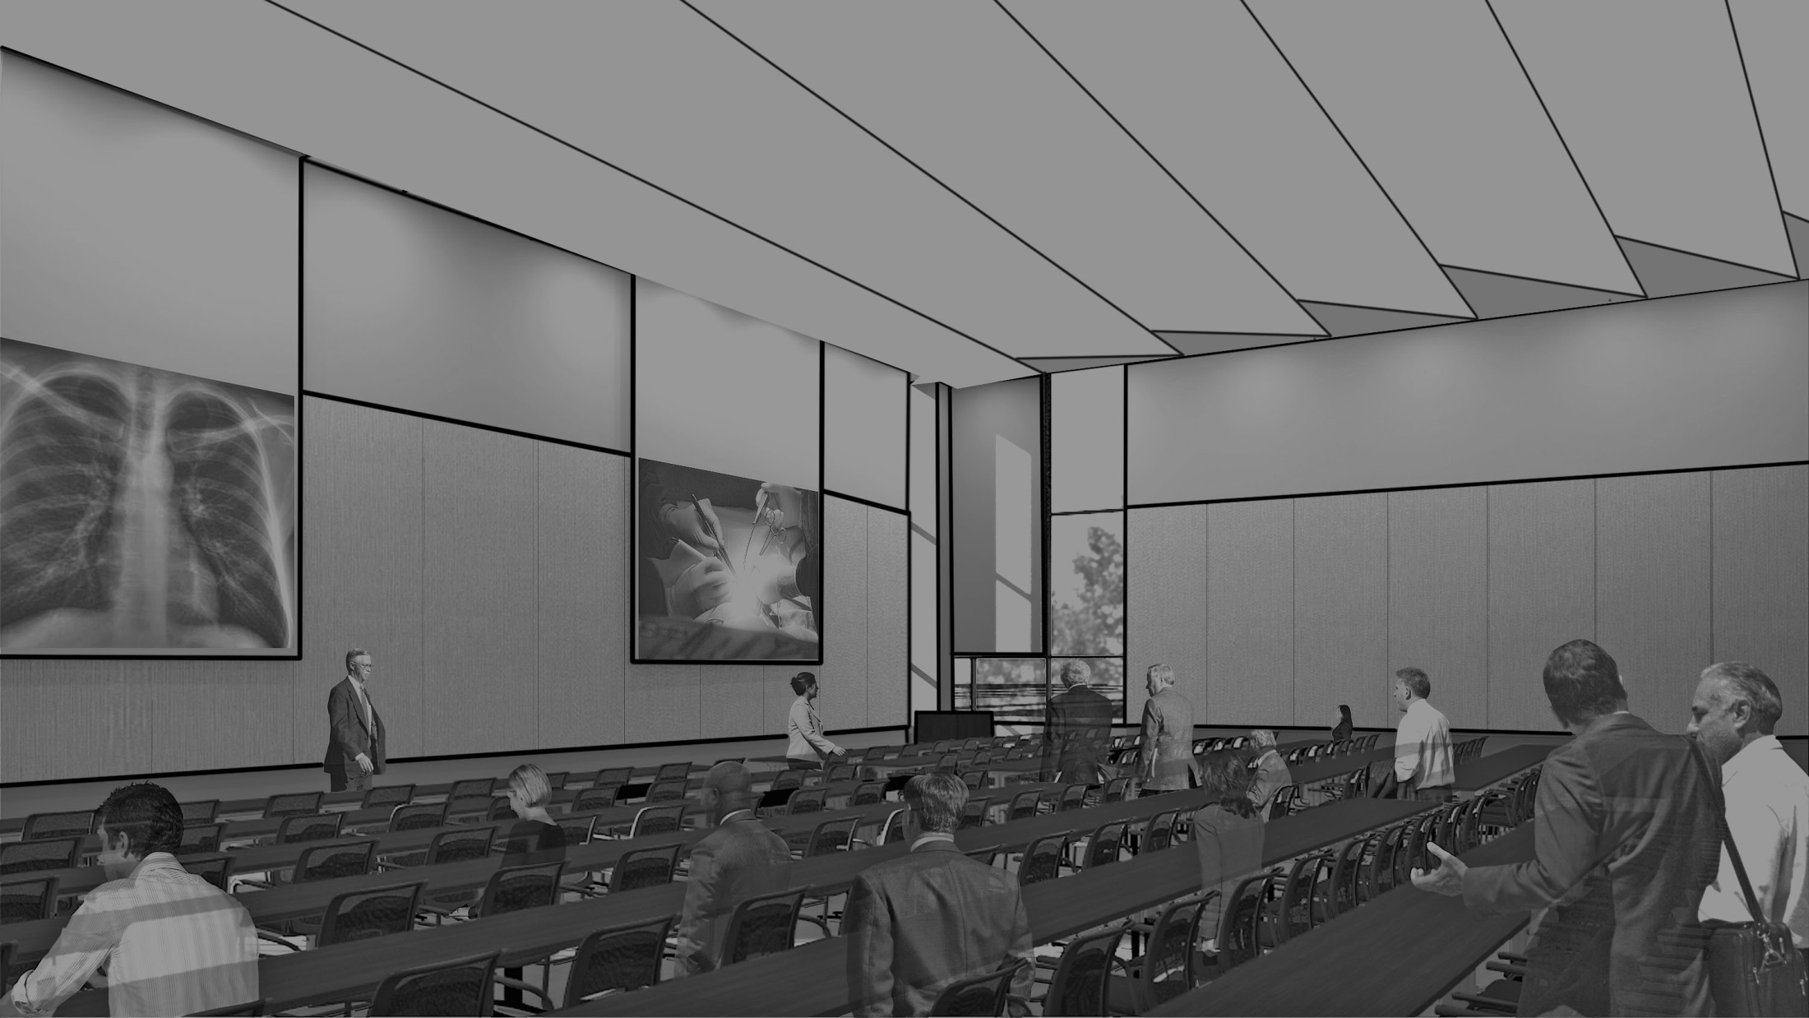
Auditorium> Schematic Design

Slide 42
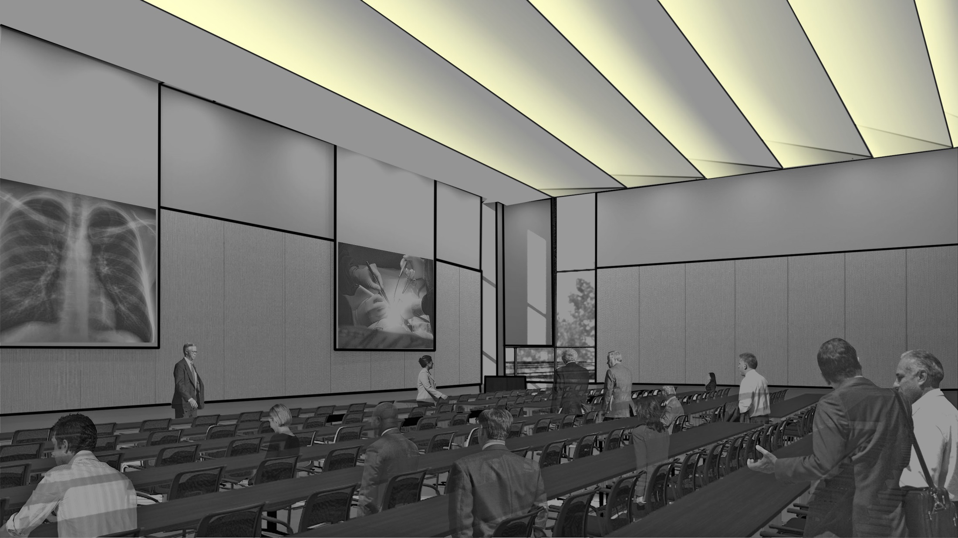
Auditorium> Schematic Design

Slide 43
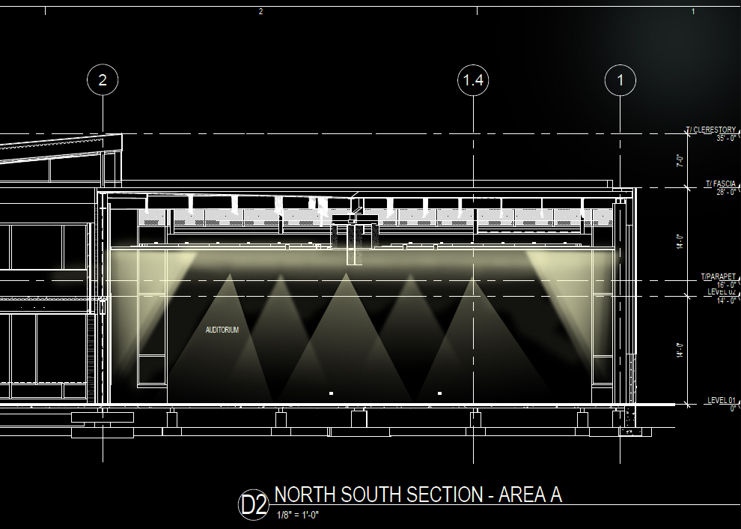
Auditorium> Psychological Impression > Spacious
Ambient lighting creates uniformity
Walls and ceiling highlighted
Deconstructed ceiling creates the illusion of a extended space beyond the actual ceiling

Slide 44


Auditorium> Schematic Design
+ Task Lighting
+ A/V Controls
+ Reading/Writing

Slide 45




THE END

Slide 46
THE END

